Slide 1
Introduction to DEEP LEARNING

Slide 2
Why Deep Learning?
■ Are we using deep learning techniques in our daily life?
3

Slide 3
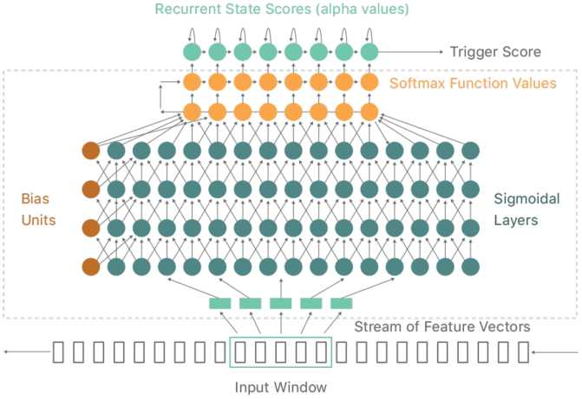

Why Deep Learning?
■ Speech recognition
4
Image source: https://machinelearning.apple.com/research/hey-siri

Slide 4
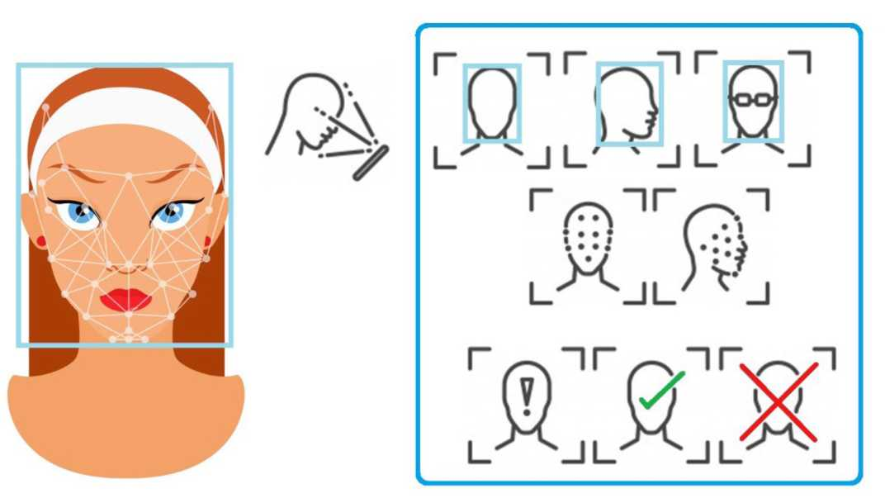
Why Deep Learning?
■ Face verification
5
Image source: https://medium.eom/@feniiro/face-id-deep-learning-for-face-recognition-324b50d9l6d 1

Slide 5
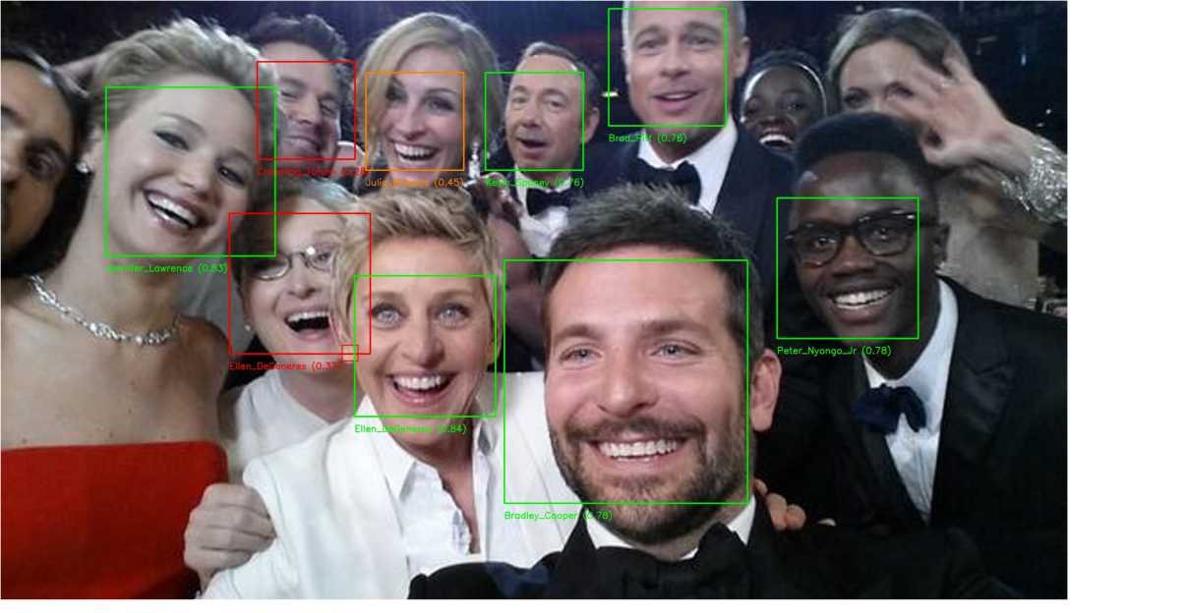
Why Deep Learning?
■ Face identification
Image source: https://towardsdatascience.com/an-intro-to-deep-learning-for-face-recognition-aa8dfbbc5lfb

Slide 6
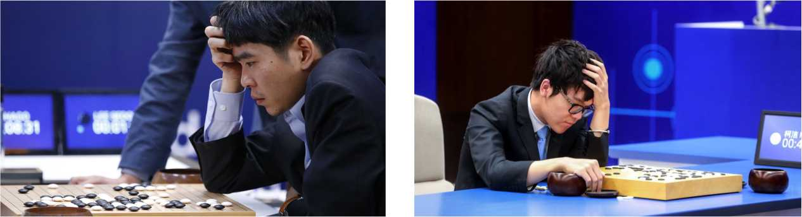
i
Why Deep Learning?
■ Playgames
AlphaGo vs. Lee Sedol 4-1, 2016 AlphaGo vs. Ke Jie 3-0, 2017
7
Image source: https://medium.com/point-nine-news/what-does-alphago-vs-8dadec65aaf
https://www.npr.org/sections/thetwo-way/20l7/05/25/5300l6562/google-a-i-clinches-series-against-humanitys-last-best-hope-to-win-at-go

Slide 7
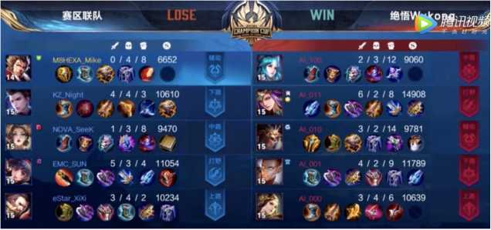
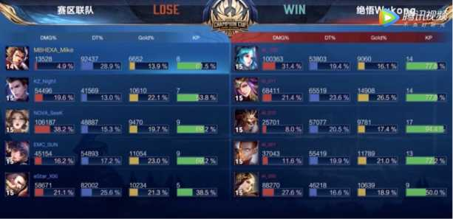
Why Deep Learning?
■ Playgames
In 2019, AI player Juewu developed by Tencent defeated pro players in
game Honor of Kings (i^^0)
8
Image source: https://blog.csdn.net/qq 39521554/article/details/104402528

Slide 8
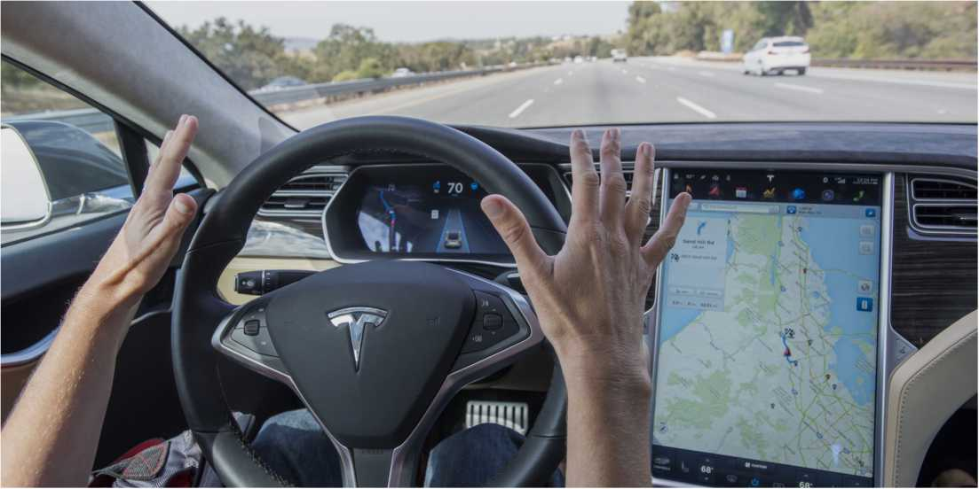
Why Deep Learning?
■ Autopilot
9
Image source: https://electrek.co/20l6/05/30/google-deep-learning-andrew-ng-tesla-autopilot-irresponsible/

Slide 9
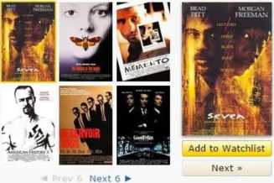
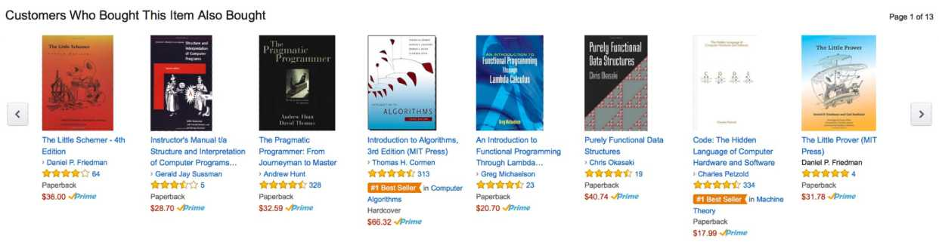
Why Deep Learning?
■ Recommender system
People who liked this also liked...
Learn more
Yedi (1995)
Certificate: 13+ Crime I Drama I Mystery
********** 8,6
Two detectives, a rookie and a veteran, hunt a serial killer who uses the seven deadly sins as his modus operandi.
Director David Fincher
Stars: Morgan Freeman, Brad Pitt,
10
Image source: https://www.mckinsey.com/industries/retail/our-insights/how-retailers-can-keep-up-with-consumers

Slide 10
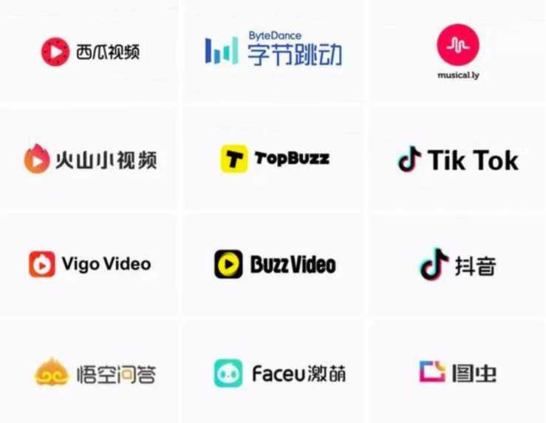
Why Deep Learning?
■ Recommender system
11
Image source: https://pandaily.com/bytedance-rumored-to-hit-20-billion-revenue-goal-for-20l9/

Slide 11
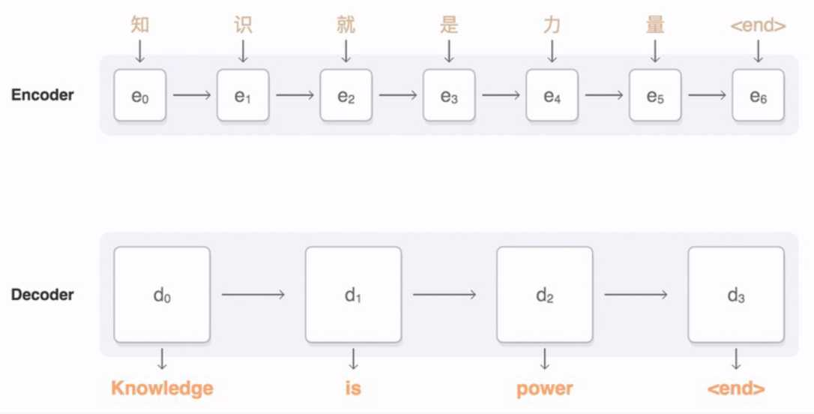
Why Deep Learning?
■ Machine translation
Machine translation by seq2seq model
12
Image source: https://google.github.io/seq2seq/

Slide 12
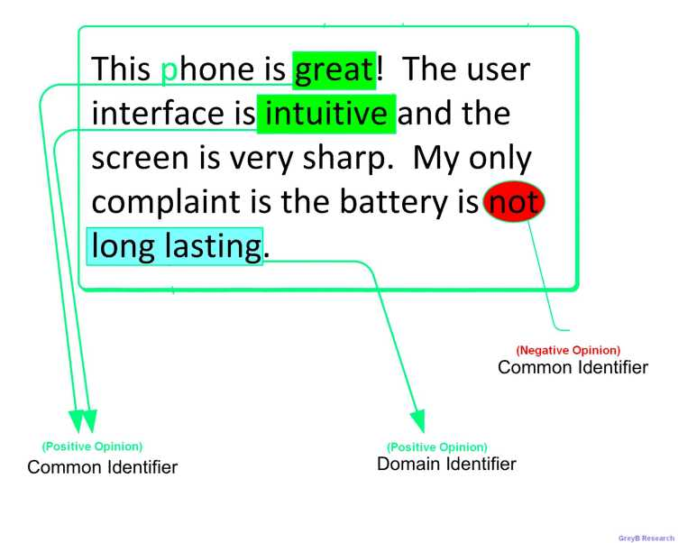
Why Deep Learning?
■ Sentiment analysis
13
Image source: http://www.whatafuture.com/microsoft-using-sentiment-analysis-software-to-predict-product-reviews/

Slide 13
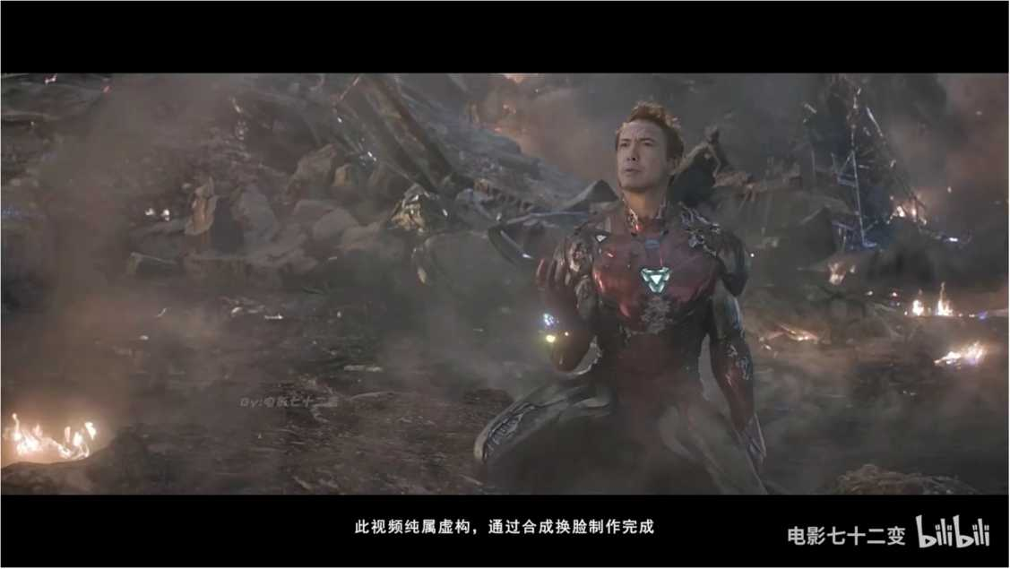
Why Deep Learning?
■ Recreation
14
Video source: https://www.bilibili.com/video/BVIMV4llz7Vh?from=search&seid=322l00575569320645

Slide 14
Deep Learning is Becoming Ubiquitous
■ Deep learning is enabling AI's to become an everyday part of life.
■ Working, studying, eating, shopping, entertaining...
■ Deep learning not only influences computer science, but also in many other areas:
■ Medical science
■ Biology
■ Chemistry
■ Marketing
■ Accounting ■.
17

Slide 15
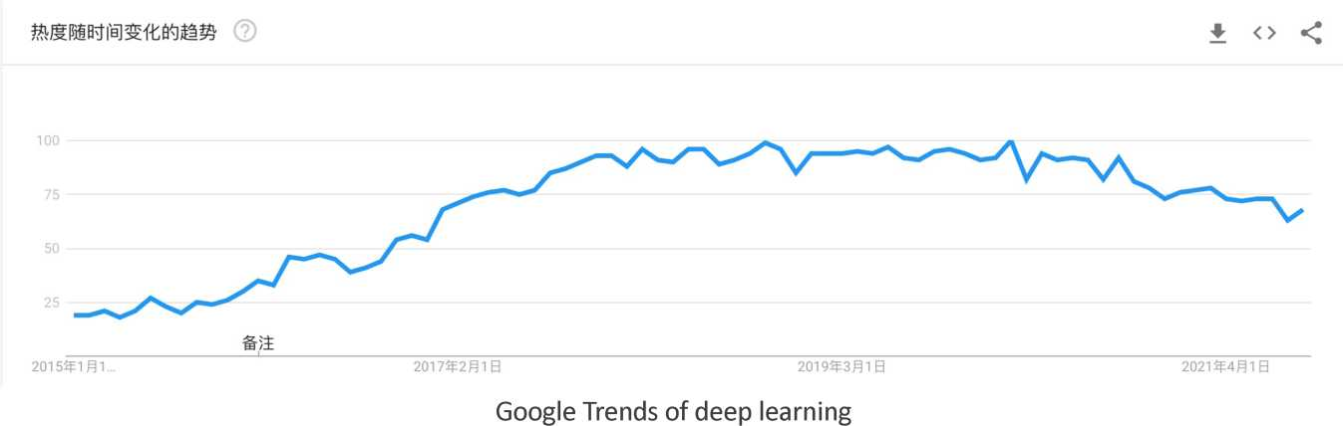
Deep Learning Development Trends
18
Data source: https://trends.google.com/trends/explore?date=20l5-0I -0I%202020-08-25&q=deep%20learning

Slide 16
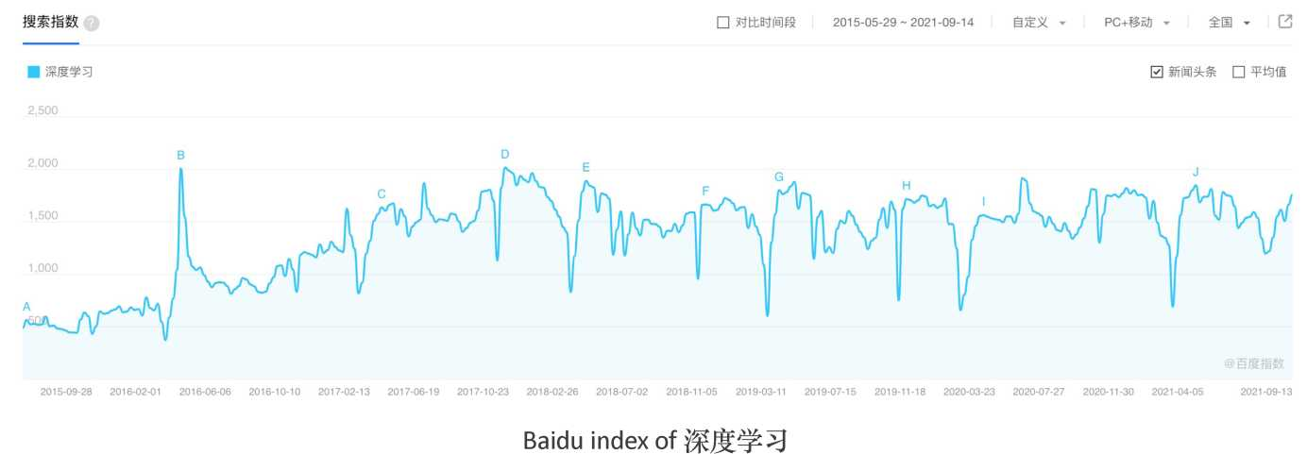
Deep Learning Development Trends
19
Data source: http://index.baidu.com/v2/main/index.html#/trend/%E6%B7%BI%E5%BA%A6%E5%AD%A6%E4%B9%A0?words=%E6%B7%BI%E5%BA%A6%E5%AD%A6%E4%B9%A0

Slide 17
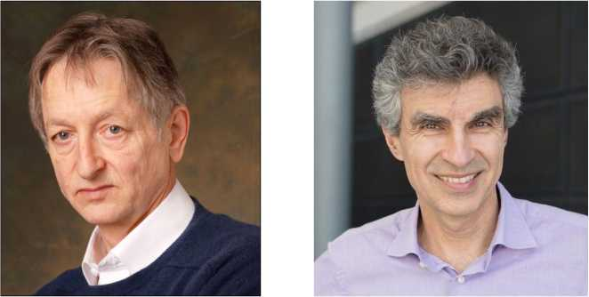
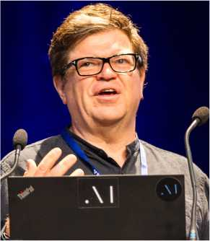
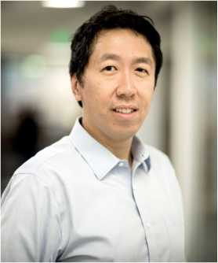
i
Deep Learning Big 4
Geoffrey Hinton
Yoshua Bengio
Yann LeCun
Andrew Ng
20

Slide 18
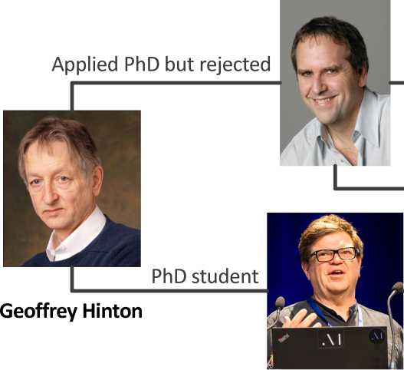

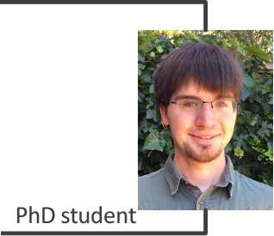
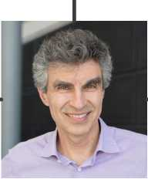
Deep Learning Big 4
Michael Jordan
Andrew Ng
PhD student
Bachelor and master student
Postdoc
Former colleague
Ian Goodfellow
Yann LeCun
Yoshua Bengio
21
SCHOOL OF INFORMATICS XIAMEN UNIVERSITY

Slide 19
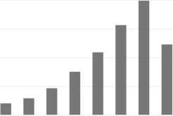
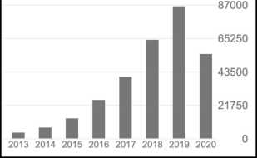
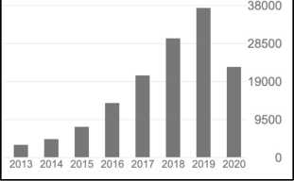
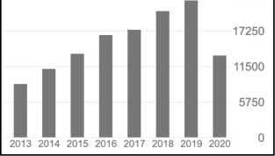
Deep Learning Big 4
 | All | Since 2015
Citations | 369842 | 270673
h-index | 156 | 114
i10-index | 351 | 261
 | All | Since 2015
Citations | 312522 | 285226
h-index | 167 | 152
i10-index | 574 | 507
 | All | Since 2015
Citations | 159826 | 132024
h-index | 123 | 104
i10-index | 285 | 235
 | All | Since 2015
Citations | 152689 | 103669
h-index | 127 | 100
i10-index | 267 | 244
23000
2013 2014 2015 2016 2017 2018 2019 2020
Geoffrey Hinton
Yoshua Bengio
Yann LeCun
Andrew Ng
22
SCHOOL OF INFORMATICS XIAMEN UNIVERSITY
Data source: Google Scholar 2020

Slide 20
History of Deep Learning
■ Deep learning has had a long and rich history, dating back to the 1940s.
■ It has gone through many different names, and has only recently become called "deep learning."
■ Generally, there were three waves in the development of deep learning.
23

Slide 21
First Wave
■ Deep learning was known as cybernetics in the 1940s-1960s.
■ The initial model was inspired by the biological brain. Therefore, it is also called artificial neural networks (ANNs).
■ Many concepts can be traced back to that time: neurons, hidden layers, stochastic gradient descent, activation functions...
■ We did not know enough about biological learning for neuroscience to offer much guidance for the learning algorithms we use to train these architectures.
24

Slide 22
Second Wave
■ In the 1980s, the second wave emerged in great part via a movement called connectionism.
■ In this wave, a major accomplishment is the successful use of back-propagation to train deep neural networks, which was proposed by Geoffrey Hinton.
■ During the 1990s, researchers made important advances in modeling sequences with neural networks.
■ Recurrent neural networks (RNN) and long short-term memory (LSTM) were proposed at that time.
■ Convolutional neural networks (CNN) was proposed in 1998 by Yann LeCun.
25

Slide 23
Second Wave
■ At this point in time, deep networks were generally believed to be very difficult to train.
■ Too computationally costly to allow much experimentation with the hardware available at the time.
■ On the other hand, other fields of machine learning algorithms like kernel machines (SVM) achieved good results on many important tasks.
■ These two factors led to a decline in the popularity of neural networks that lasted until 2007.
26

Slide 24
Third Wave
■ The third wave began from 2006, when Geoffrey Hinton showed that a kind of neural network called a deep belief network could be efficiently trained.
■ The researchers quickly showed that the same strategy could be used to train many other kinds of deep networks.
■ The term "deep learning" is then used to emphasize that researchers were now able to train deeper neural networks than had been possible before.
■ At this time, deep neural networks outperformed competing AI systems based on other machine learning technologies as well as hand-designed functionality.
27

Slide 25
Third Wave
■ Deep learning milestones:
■ In 2012, AlexNet competed in the ImageNet Large Scale Visual Recognition Challenge. The network achieved a top-5 error of 15.3%, more than 10.8 percentage points lower than that of the runner up.
■ In 2015, ImageNet challenge declared that machines are now outperforming humans on the task of image recognition.
■ In 2016, AlphaGo defeated Lee Sedol.
■ In 2019, Geoffrey Hinton, Yoshua Bengio and Yann LeCun were awarded the Turing Award for conceptual and engineering breakthroughs that have made deep neural networks a critical component of computing.
28

Slide 26
Third Wave
Key reasons of the success of deep learning in the third wave:
■ Increasing dataset sizes.
■ Increasing model sizes.
■ Increasing accuracy, complexity and real-world impact.
29

Slide 27
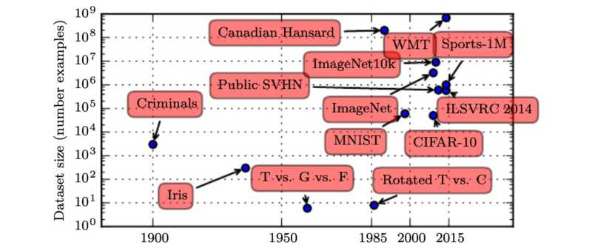
Increasing Dataset Sizes
■ The most important new development is that today we can provide these algorithms with the resources they need to succeed.
■ As of 2016, a rough rule of thumb is that a supervised deep learning algorithm
■ will generally achieve acceptable performance with around 5,000 labeled examples per category;
■ will match or exceed human performance when trained with a dataset containing at least 10 million labeled examples.
30
Image source: Figure 1.8, Goodfellow, Bengio, and Courville, Deep Learning, Cambridge: MIT press, 2016.

Slide 28
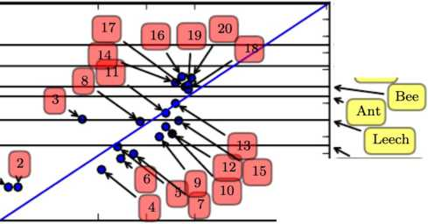
Increasing Model Sizes
1. Perceptron (Rosenblatt, 1958, 1962)
2. Adaptive linear element (Widrow and Hoff, 1960)
3. Neocognitron (Fukushima, 1980)
4. Early back-propagation network (Rumelhart et al., 1986b)
5. Recurrent neural network for speech recognition (Robinson and Fallside, 1991)
6. Multilayer perceptron for speech recognition (Bengio et al., 1991)
7. Mean field sigmoid belief network (Saul et al., 1996)
8. LeNet-5 (LeCun et al., 1998b)
9. Echo state network (Jaeger and Haas, 2004)
10. Deep belief network (Hinton et al., 2006)
11. GPU-accelerated convolutional network (Chellapilla et al., 2006)
12. Deep Boltzmann machine (Salakhutdinov and Hinton, 2009a)
13. GPU-accelerated deep belief network (Raina et al., 2009)
14. Unsupervised convolutional network (Jarrett et al., 2009)
15. GPU-accelerated multilayer perceptron (Ciresan et al., 2010)
16. OMP-1 network (Coates and Ng, 2011)
17. Distributed autoencoder (Le et al., 2012)
18. Multi-GPU convolutional network (Krizhevsky et al., 2012)
19. COTS HPC unsupervised convolutional network (Coates et al., 2013)
20. GoogLeNet (Szegedy et al., 2014a)
Number of neurons (logarithmic scale)
Human j
| Octopus j
Prog
- Roundworm
1950
1985 2000 2015
2056
Sponge!
In 2020, the language model Generative Pre-trained Transformer 3 (GPT-3) has 175 billion (10¹¹) parameters!
31
Image source: Figure 1.11, Goodfellow, Bengio, and Courville, Deep Learning, Cambridge: MIT press, 2016.

Slide 29
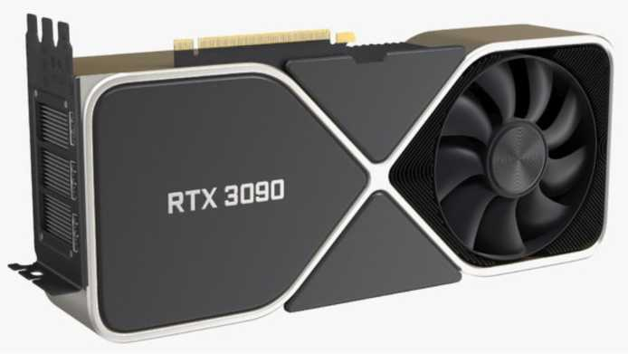
Increasing Model Sizes
■ We have the computational resources to run much larger models today.
■ Larger networks are able to achieve higher accuracy on more complex tasks.
■ Hardware development, with some GPUs designed specifically for deep learning (rather than video games) have accelerated the training of bigger models.
Nvidia RTX3090
32
Image source: https://static.turbosquid.com/Preview/2020/10/30 23 25 l3/NvidiaGeForceRTX3090FoundersEditionvray3dmodel00I.ipgEEE080l3-CE96-4B46-AC3B-C62F2234B776Large.ipg

Slide 30
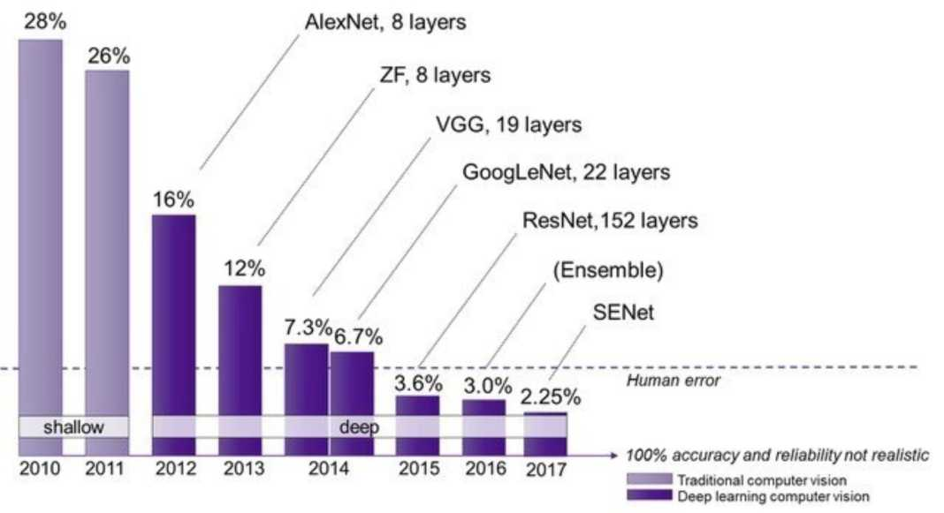
Increasing Accuracy, Complexity and Real-World Impact
ImageNet Large Scale Visual Recognition Challenge (ILSVRC) winners
33
Image source: https://semiengineering.com/new-vision-technologies-for-real-world-applications/

Slide 31
Deep Learning Top Conferences
■ Machine learning:
■ Neural Information Processing Systems (NeurIPS, formerly abbreviated as NIPS)
■ International Conference on Machine Learning (ICML)
■ International Conference on Learning Representations (ICLR)
■ Computer vision:
■ IEEE/CVF Conference on Computer Vision and Pattern Recognition (CVPR)
■ International Conference on Computer Vision (ICCV)
■ European Conference on Computer Vision (ECCV)
■ Natural language processing:
■ Association for Computational Linguistics (ACL)
■ Empirical Methods in Natural Language Processing (EMNLP)
■ North American Chapter of the Association for Computational Linguistics (NAACL)
■ AI:
■ International Joint Conference on Artificial Intelligence (IJCAI)
■ Association for the Advancement of Artificial Intelligence (AAAI)
34

